Slide 1
Discussion 6:
Object Oriented Programming
Chae Park (chae@berkeley.edu)
Discussion 30
March 6, 2019
Slides: links.cs61a.org/chae-slides
*Slides cred to Tammy Nguyen*

Slide 2
Announcements!
Ants project is released
Checkpoint 1 is due Monday 3/11
The entire project is due Thursday 3/14
Submit a day early to earn an extra point!
HW 5 / Lab 6 are due Friday 3/8
One on one check in with a staff member. Still a few slots left (Piazza @1837)
Midterm 2 is coming up soon!!
Notes:
Mention this week’s lab situation

Slide 3
Agenda
OOP
Inheritance

Slide 4
Object Oriented Programming

Slide 5
Recall: Abstract Data Types
Programmers like to treat data as abstractions. Why?
Hide details
Semantically easier to understand
Avoid repeating code
Abstract data types = fake data types implemented with real data types
e.g. city ADT with name, latitude, and longitude properties
e.g. tree ADT with label and branches properties
Objects = ADTs that are formalized into “real” data types
We’ve seen built in objects, e.g. lists, functions
We’ll now look at user defined objects, created using the class definition

Slide 6

Let’s make Boba!
Chelsea’s Boba
What do all bobas have in common?
They are delicious!
They can be consumed!
What are some properties of boba that are specific to Chelsea’s boba?
The tea is rose milk tea
50% Sweetness

Slide 7
Some definitions… and boba
Term | Explanation | Example
class | A template for creating objects | A template for Bobas
instance | A single object created from a class | Chelsea’s Boba
class attribute | A property of an object, specific to an instance | Is_delicious = True
instance attribute | A property of an object, shared by all instances of a class | tea_type = “rose milk” Sweetness = 0.5
method | A function in a class that all instances of the class can call | def consumed

Slide 8
ADTs vs. Classes
ADTs capture a way of thinking -- data as abstractions of details.
Classes formalize the notion of constructing and manipulating user defined data types.
 | ADTs | Classes
Constructor | constructor function: returns a new ADT represented with real data types | __init__ method: constructs and returns a new object
Attributes | selector functions: returns properties of ADT No way to change these properties. | instance attributes: specific to instances class attributes: shared between instances Attributes can be reassigned -- mutation!
Bound functions | None | instance methods: can only be called on instances of the class the methods are defined in

Slide 9
Discussion questions
Read over the class definitions on page 2 of the worksheet.
Answer these questions with the person next to you:
What are the class attributes of the Student class?
What methods can Professor instances call?
What instance attributes do Professors have?
How would you create two Student instances?

Slide 10
Discussion questions
What is/are the class attribute(s) of the Student class?
students (keeps track of number of students)
What method(s) can Professor instances call?
add_student, assist
What instance attributes(s) do Students have?
name, understanding
How would you create two Student instances?
You would first need to create a Professor object (or two) because one is required in the Student constructor. Then you would call the Student constructor twice, passing in a name and Professor for each.

Slide 11
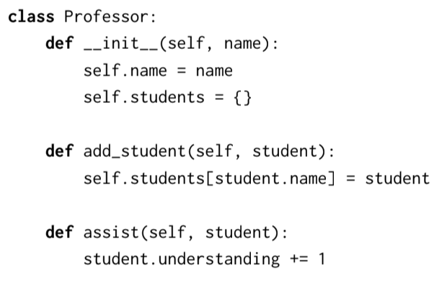
Anatomy of a class definition
class name
initialize instance attributes
constructor
method definitions

Slide 12
Functions vs. Methods
Methods must take in an additional argument “self” (must be the first argument).
The “self” argument tells the method which instance object to work with, so we know where to go to look up variables and methods.
Two ways to invoke a method:
Call the method on the class, explicitly passing in an instance: | Call the method on an instance, implicitly passing in that instance:
Professor.lecture(garcia, chae) | garcia.lecture(chae)
Here, in either case, the parameter self is bound to the object referenced by the name garcia, and the parameter student is bound to the student instance chae
Notes:
example?

Slide 13
Discussion questions
Read over the class definitions on the handout I gave you.
Answer these questions with the person next to you:
What are the class attributes of the Fruit class?
What methods can Fruit instances call?
What instance attributes do Fruit have?

Slide 14
Discussion questions
What is/are the class attribute(s) of the Fruit class?
ripe
What method(s) can Fruit instances call?
eat, can_roll
What instance attributes(s) do Fruit have?
taste, size, ripe, round

Slide 15
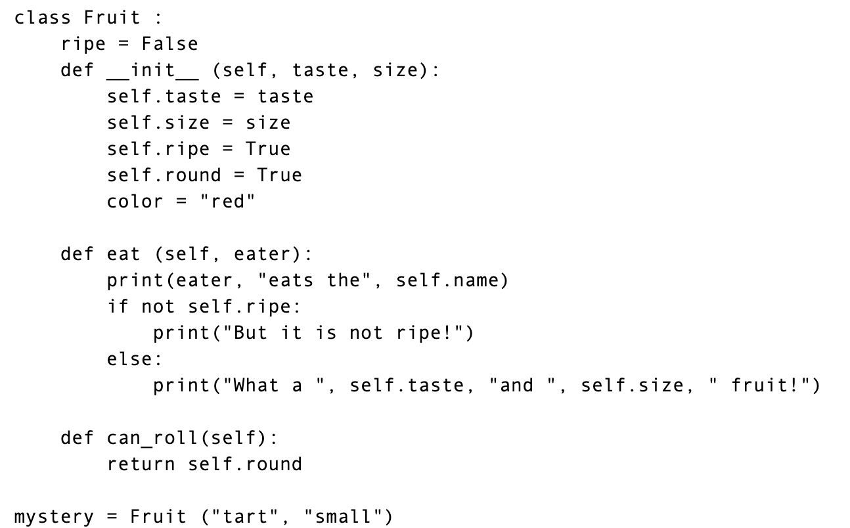
Anatomy of a class definition
class name
constructor
initialize instance attributes
method definitions

Slide 16
Functions vs. Methods
Methods must take in an additional argument “self” (must be the first argument).
The “self” argument tells the method which instance object to work with, so we know where to go to look up variables and methods.
Two ways to invoke a method:
Call the method on the class, explicitly passing in an instance: | Call the method on an instance, implicitly passing in that instance:
Fruit.eat(my_apple, “Chae”) | my_apple.eat(“Chae”)
Here, in either case, the parameter self is bound to the object referenced by the name my_apple, and the parameter eater is bound to the string “Chae”
Notes:
example?

Slide 17
Page 2 Q1.1

Slide 18
Inheritance
Notes:
10 min alone, 15 min with group

Slide 19
Hierarchy of objects
In real life, we can put objects into a hierarchy, where some objects are more specific versions of other objects.
pet
dog
cat
labrador
rottweiler
calico
tabby

Slide 20
Inheritance
Key idea: If a class is a more specific version of another class, the attributes and methods of the more general class should still apply to the more specific class.
The more general class is known as the superclass.
The more specific class is known as the subclass.
A subclass inherits all the attributes and methods of its superclass(es), but it can also override, or redefine, them.
Notes:
“Is” relationsihp

Slide 21
Inheritance example
class signature: subclass(superclass)
class Tomato(Fruit):
def eat(self):
...
def be_ketchup(self):
...
A Tomato is a more specific type of Fruit.
Tomatoes can do things that Fruits in general can do, but have some of their own unique qualities.
overriding a method: redefining a method that was inherited
new method:
Tomatoes are the only Fruits that can be ketchup!
Try it out! Handout backside

Slide 22
Inheritance example
class signature: subclass(superclass)
class Cat(Pet):
def __init__(self, name, owner):
...
def talk(self):
...
def lose_life(self):
...
A Cat is a more specific type of Pet.
Cats can do things that Pets in general can do, but have some of their own unique qualities.
overriding a method: redefining a method that was inherited
new method:
Cats are the only Pets that can lose a life!
Try it out! Problem 2.1 - Cat

Slide 23
Attendance: links.cs61a.org/chae-disc
Secret Word: Pomodoro
Anonymous Feedback: links.cs61a.org/chae-feedback

